Slide 1
A Cemetery of Attributions
Do we have to end up there too?
François Normandin
CLA Summit Americas 2018 – 7x7

Slide 2
Why we contribute to Open Source
Create an ecosystem to support our work
Marketing purposes
Peer recognition
Learning
Notes:
Reference Derek’s presentation about how bad we are at open source... Certainly it will be awesome as usual.

Slide 3
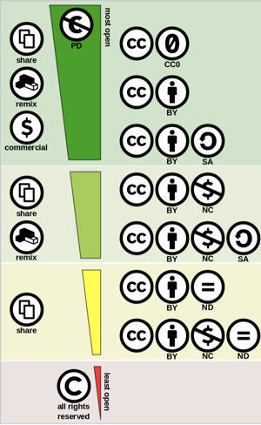
Licensing types
Attribution
Share-Alike
Non-Commercial
No Derivatives
https://en.wikipedia.org/wiki/Creative_Commons_license#/media/File:Creative_commons_license_spectrum.svg
Shaddim 2016, CC BY 4.0
Notes:
List types of licenses
Attribution: Mention the original author
Share-Alike: Allows derivatives if identical or not more restrictive license of the derivative work
Non-Commercial
No Derivatives: can use and redistribute

Slide 4
A Cemetery of Attributions
Third-Party Notices...
Check this out:
https://www.adobe.com/content/dam/acom/en/products/eula/third_party/pdfs/adobe-third-party-notices.pdf
Notes:
Show the 3rd party notices of Adobe

Slide 5
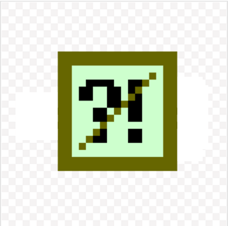


A funny example of Attributions
Notes:
Show the OpenG Error license.
This is an excellent example of good intentions but clearly not worth an attribution!

Slide 6
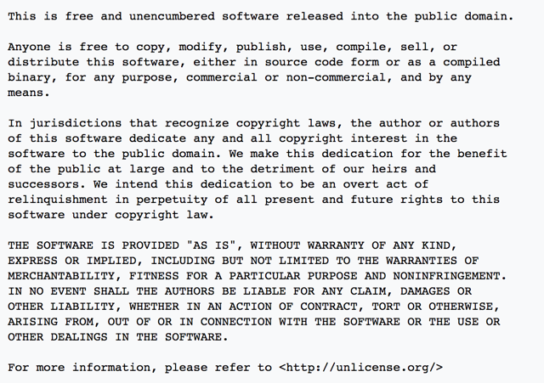
The Unlicense
Notes:
Show the « Unlicense » license.
Public Domain with a Fallback if not in a jurisdiction where it is recognized

Slide 7
LabVIEW Open Source Project
LabVIEW Open Source Project on GitHub
https://github.com/LabVIEW-Open-Source
Notes:
Describe this new initiative

